Slide 1

Relationship between BMI and health indicators

Slide 2
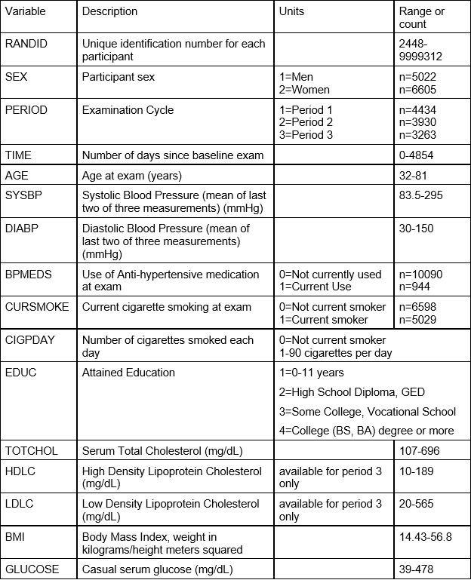
Health Indicators Used

Slide 3
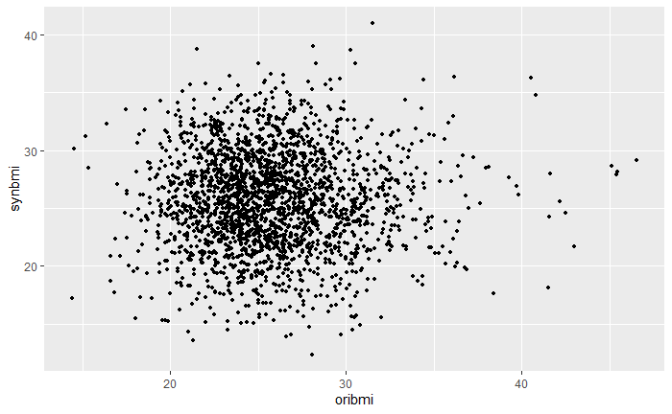
Synthetic model built using the continuous health indicators

Slide 4
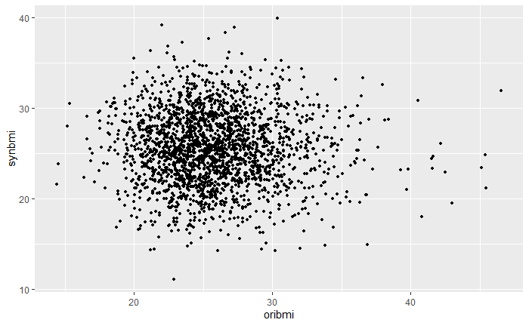
Synthetic model built using the discrete health indicators

Slide 5
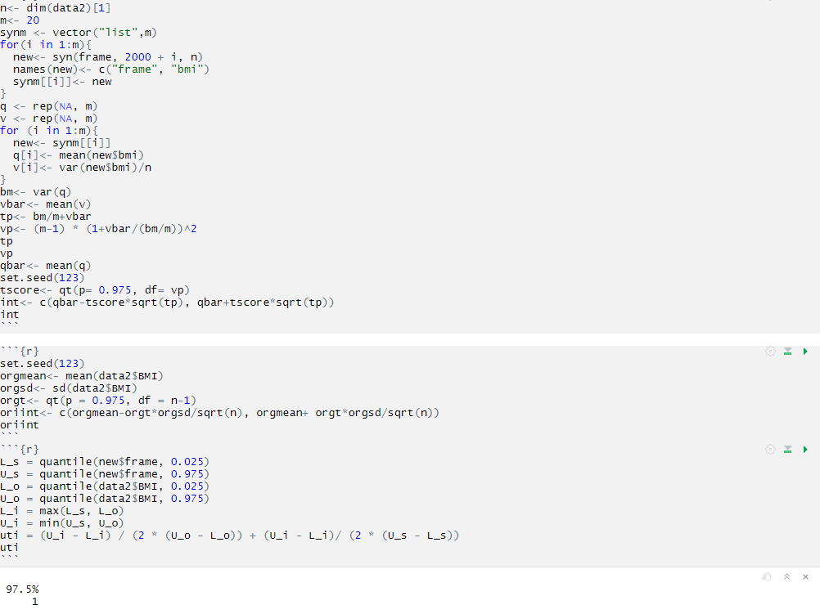
Utility Evaluation

